Slide 1
Concept Map:
Fine-Tuning and Masked Language Models
Team No: 32
Members:
Saman Sarker Joy - 20101114
Tanusree Das Aishi - 20101012
Naima Tahsin Nodi - 20101150
ST: Sadiul Arefin Rafi
RA: Md Sabbir Hossain

Slide 2
Basic Information
Book Name: Speech and Language Processing
Authors: Dan Jurafsky and James H. Martin
Edition: 3rd ed. draft
Year: Jan 7, 2023
Publisher: Prentice Hall
Chapter Name: Fine-Tuning and Masked Language Models

Slide 3
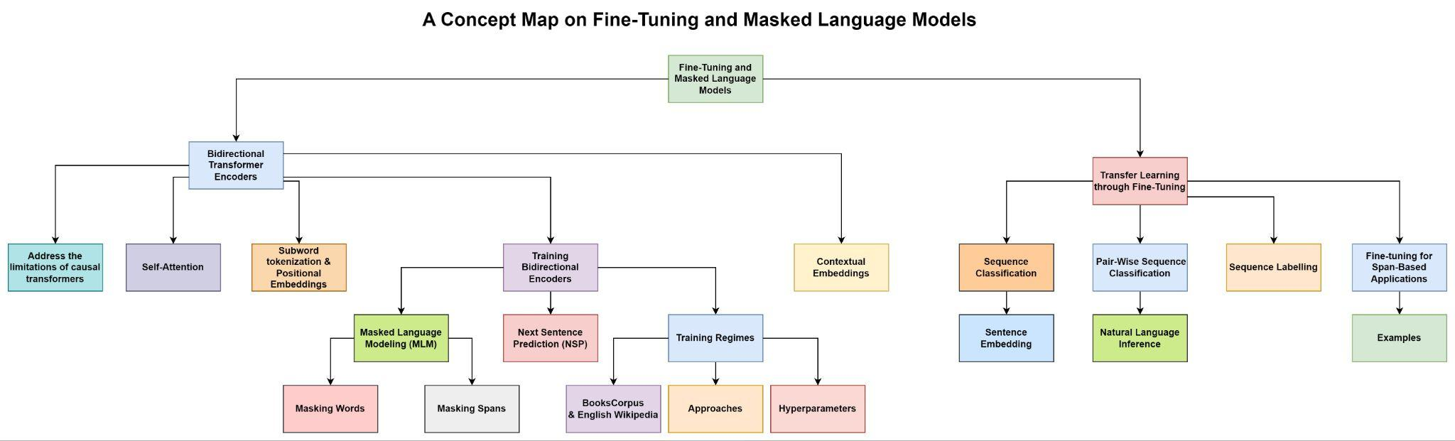

Slide 4
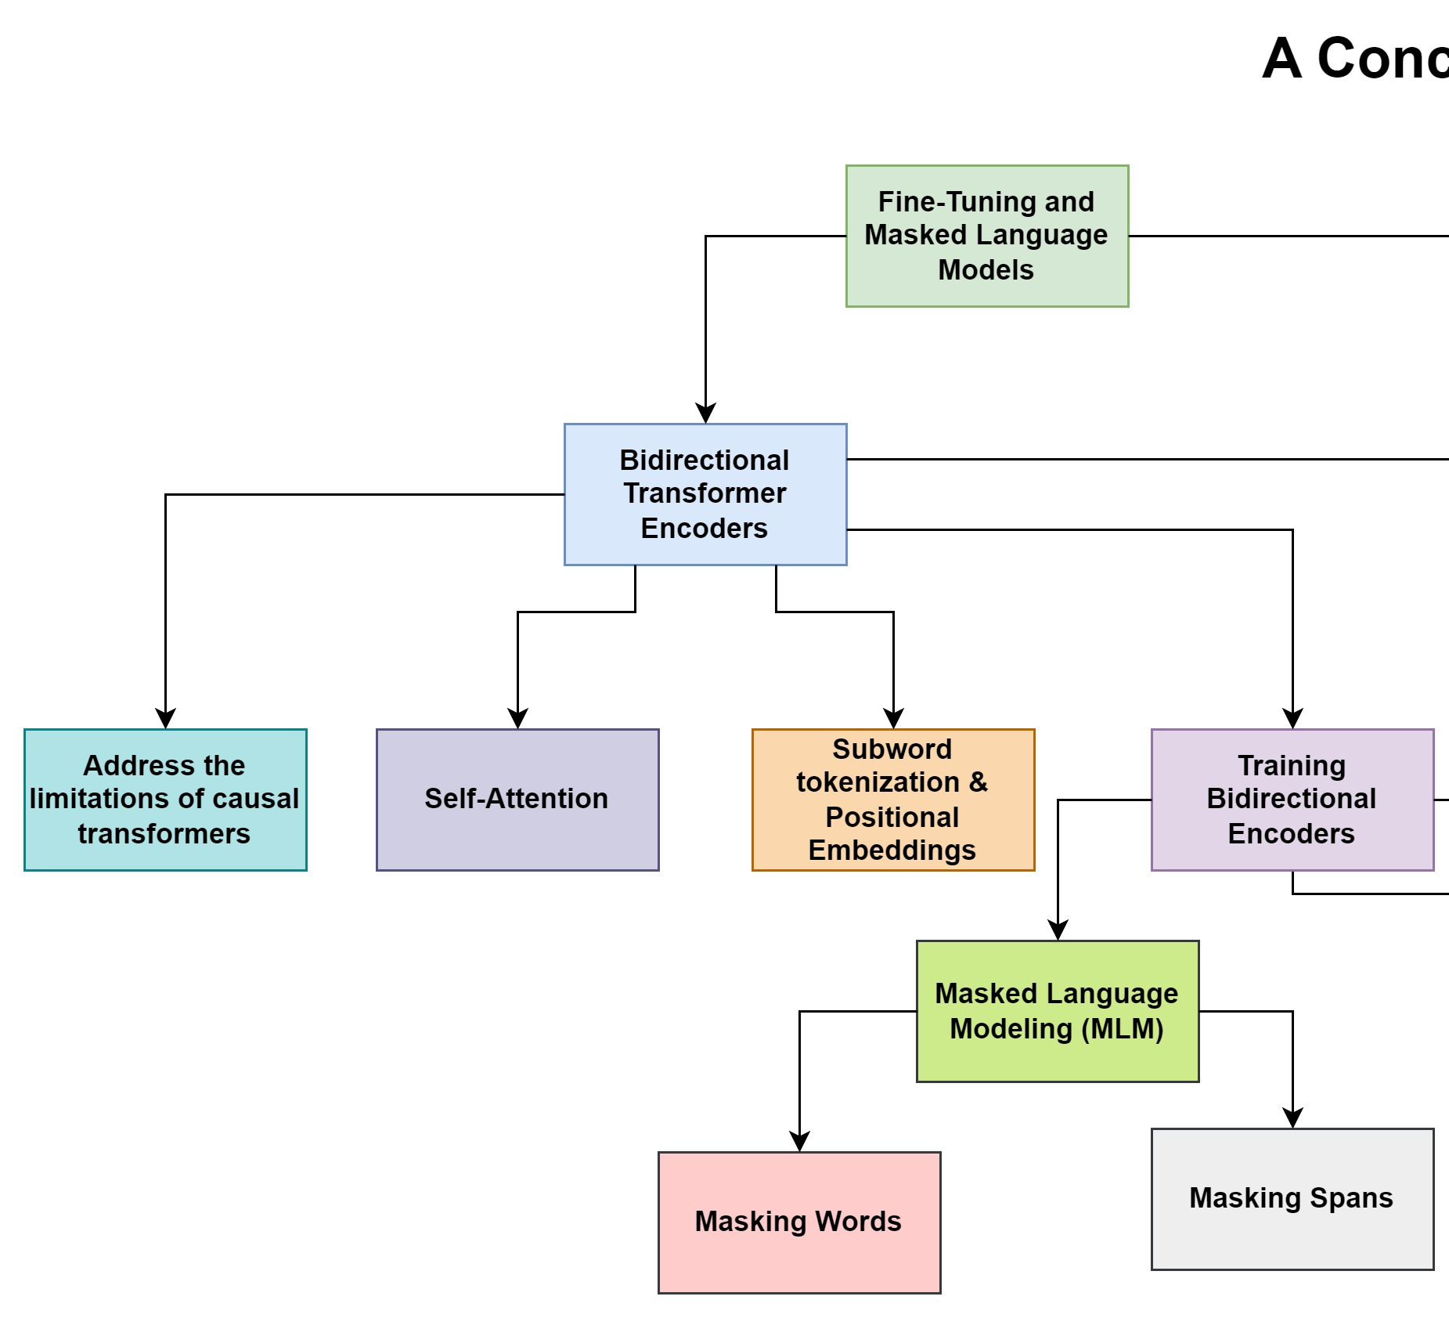

Slide 5
Bidirectional Transformer Encoders
Bidirectional Transformer Encoders are the underlying models for popular language models like BERT, RoBERTa, and SpanBERT.
These models overcome the limitations of causal (left-to-right) transformers, which are powerful for autoregressive generation tasks but have shortcomings in sequence classification and labeling problems.
Bidirectional encoders allow the self-attention mechanism to consider information from both the left and right contexts of each element in the input sequence.
The focus of bidirectional encoders is to compute contextualized representations of tokens that are useful across a range of downstream applications.
Self-attention is used to map sequences of input embeddings to contextualized output embeddings by considering information from the entire input sequence.

Slide 6
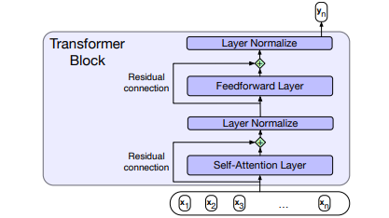
Self-Attention
Image: Self Attention
It allows tokens to weigh the importance of other tokens in a sequence.
Self-attention computes similarity scores between query and key embeddings.
The scores are scaled, passed through a softmax function, and used as weights.
Weighted values are combined to create contextualized representations.
Self-attention captures dependencies and relationships among tokens.
It enables the model to understand context and make informed predictions.

Slide 7
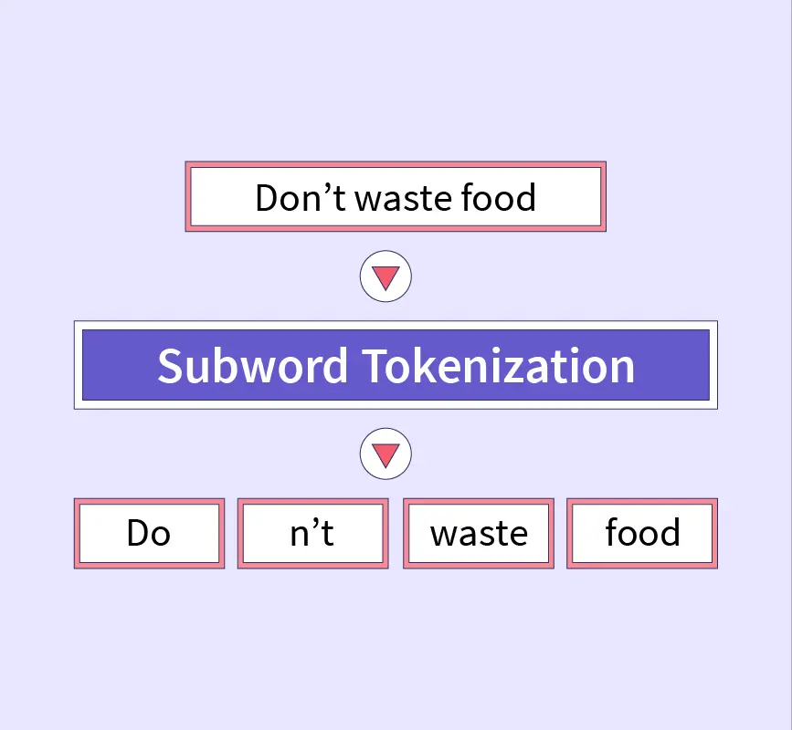
Subword Tokenization & Positional Embeddings
Subword tokenization breaks words into smaller units called subword tokens.
It helps handle out-of-vocabulary words and captures morphological variations.
WordPiece is a commonly used subword tokenization algorithm.
—---------------------------------------------------------------------------------------
Positional embeddings convey the relative positions of tokens in a sequence.
They are added to the input embeddings to capture sequential information.
They help the model understand the order and context of tokens in the text.
Image: Subword Tokenization

Slide 8
Training Bidirectional Encoders
Masked Language Modelling (MLM): The objective is to encourage the model to understand the context and meaning of the surrounding words in order to accurately predict the masked words.
Masking Words: Randomly mask words and predict them during training
Masking Spans: Mask consecutive spans of tokens for improved handling of phrases

Slide 9
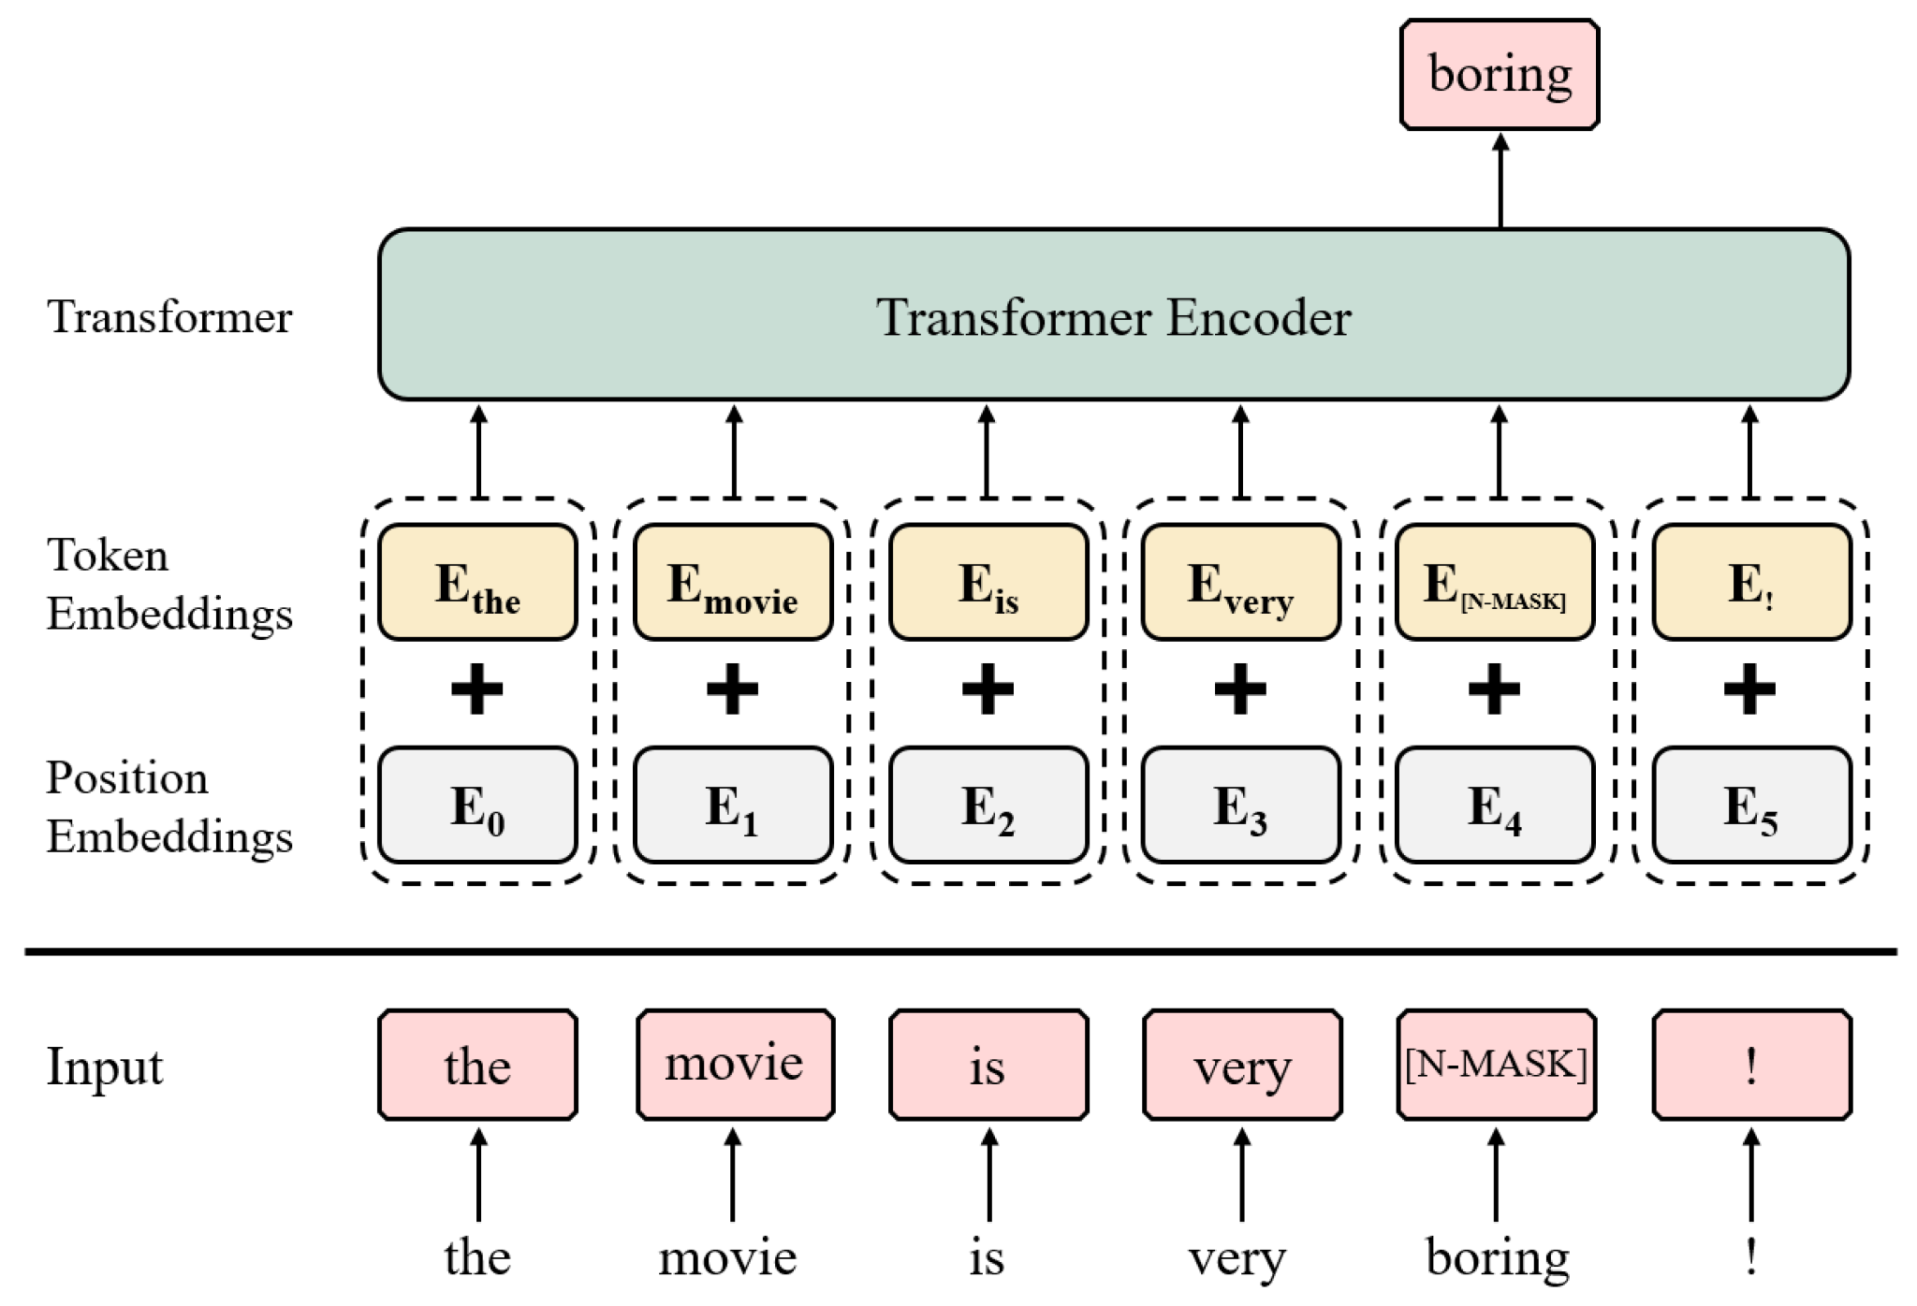
Training Bidirectional Encoders Cont.
MLM utilizes unannotated text from a large corpus for training.
During MLM, a portion of the input sequence is randomly selected for masking.
The model's objective is to predict the original masked tokens based on the context provided by the surrounding words.
The training process involves minimizing the cross-entropy loss between the model's predictions and the actual masked tokens.
Image: MLM

Slide 10
Training Bidirectional Encoders Cont.
In MLM, a percentage of input tokens are randomly chosen for masking.
Typically, around 15% of the input tokens are selected for masking.
The masked tokens are then replaced as described above (with [MASK], random token, or unchanged).
The model is trained to predict the original masked words by considering the context provided by the remaining tokens in the sequence.

Slide 11
Training Bidirectional Encoders Cont.
Masking spans involves selecting contiguous sequences of words, also known as spans, from the input text.
These spans are then masked by replacing the words within the span, similar to the masking of individual words.
Masking spans is particularly useful for tasks that involve identifying and classifying larger units of text, such as question answering, syntactic parsing, and coreference resolution.
The objective is to predict the masked words within the span based on the surrounding context.

Slide 12
Training Bidirectional Encoders Cont.
The Span Boundary Objective (SBO) is an additional objective used in span-based masking.
SBO focuses on predicting the words within a masked span using the words preceding and following the span.
The model learns to associate the boundaries of a span with the words inside it, enabling better understanding of span-based relationships.
SBO augments the MLM objective by incorporating predictions of words within a span, using output vectors and positional embeddings.

Slide 13
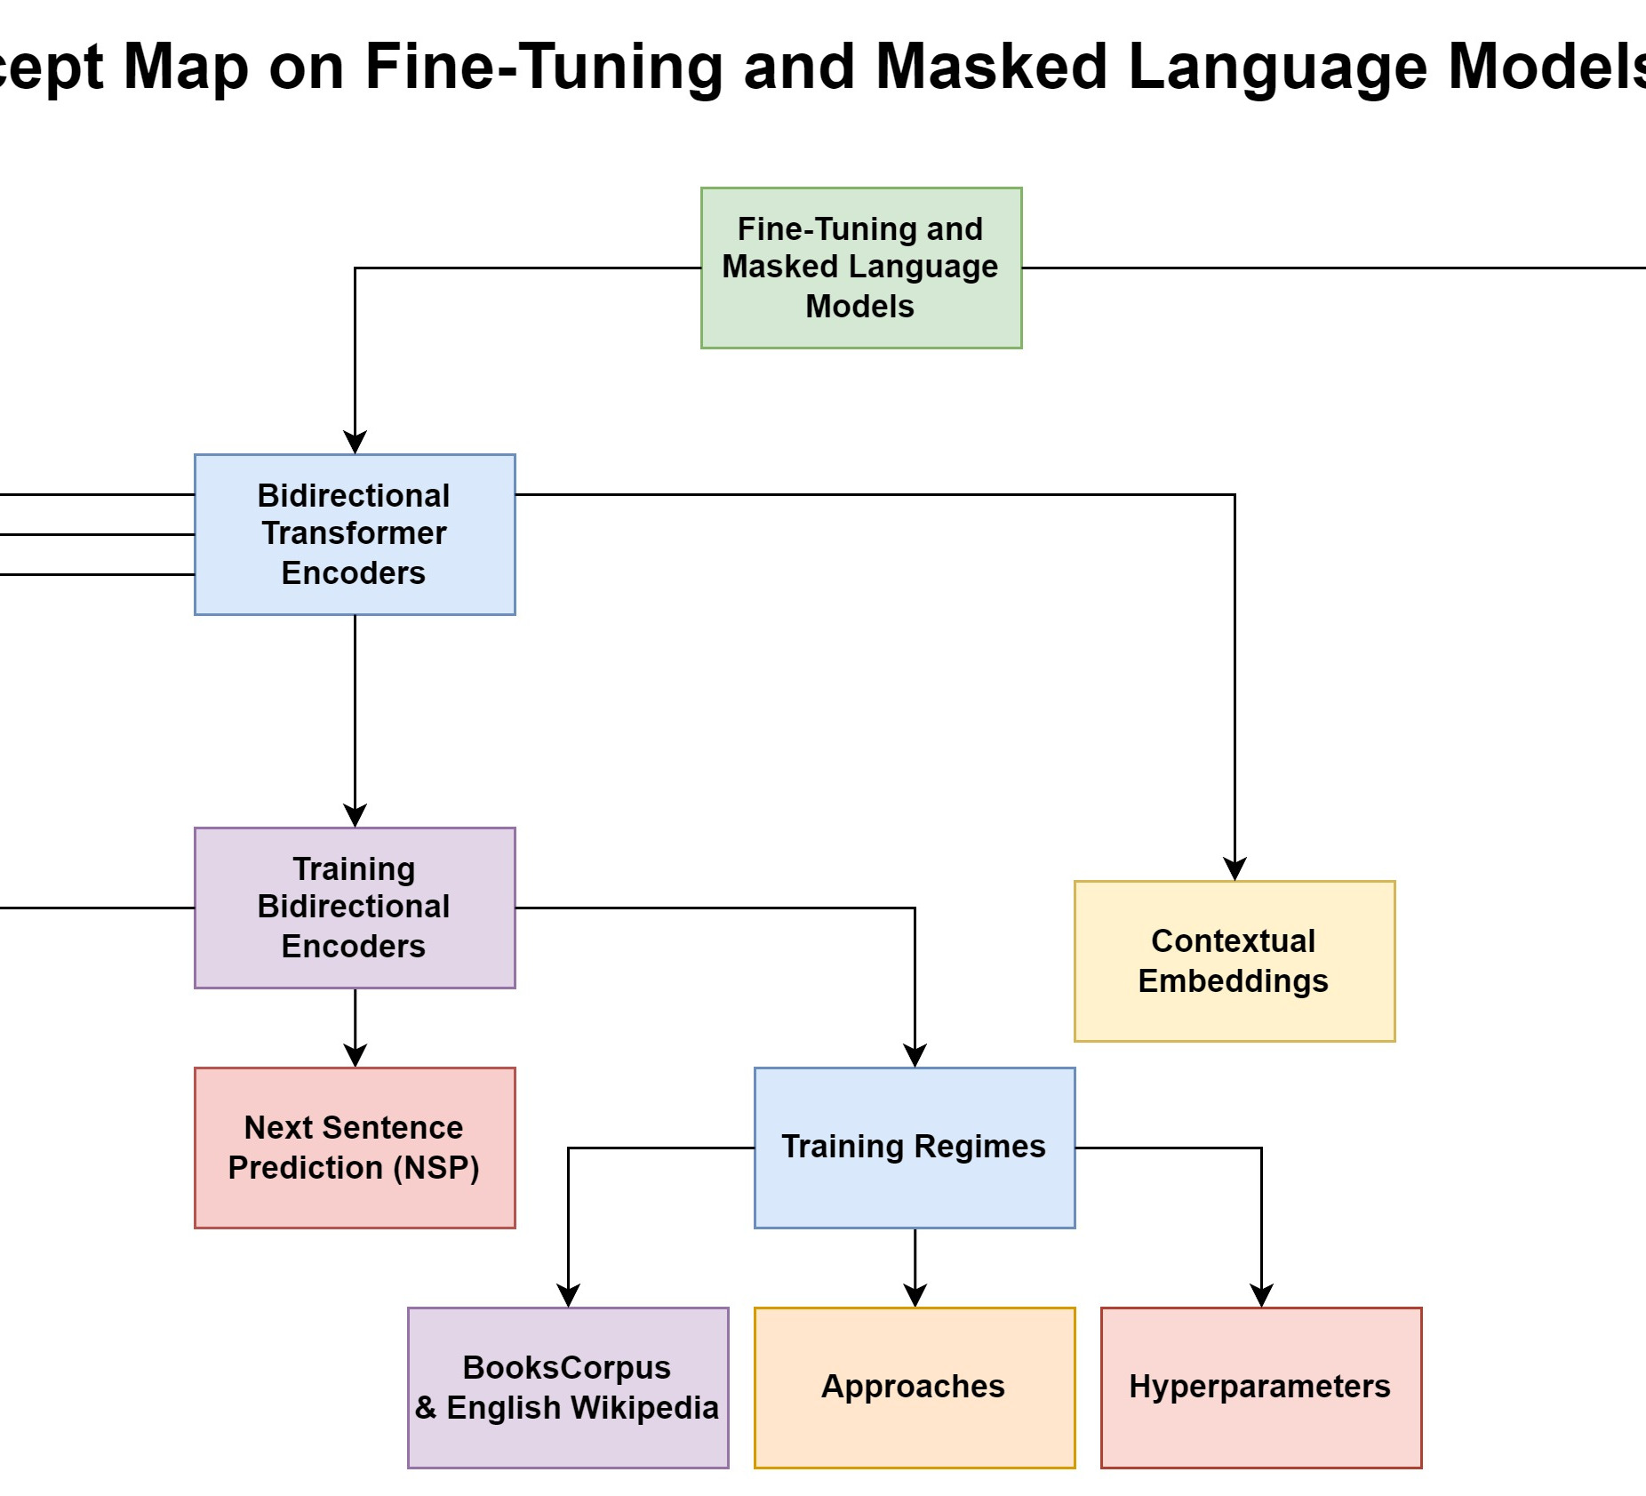

Slide 14
Next Sentence Prediction (NSP)
A learning objective introduced to train BERT, to capture the knowledge determining the relationship between pairs of sentences that includes tasks such as : paraphrase detection, entailment or discourse coherence
The model is presented with pairs of sentences and is asked to predict whether each pair consists of an actual pair of adjacent sentences from the training corpus or a pair of unrelated sentences
In BERT, 50% of the training pairs consisted of positive pairs, and in the other 50% the second sentence of a pair was randomly selected from elsewhere in the corpus

Slide 15
Next Sentence Prediction (NSP) Cont.
To facilitate NSP training, BERT introduces two new tokens to the input representation
During training, the output vector from the final layer associated with the [CLS] token represents the next sentence prediction.
Cross entropy is used to compute the NSP loss for each sentence pair presented to the model

Slide 16
Training Regimes
The corpus used in training consisted of an 800 million word corpus of book texts called BooksCorpus
Along with a 2.5 Billion word corpus derived from the English Wikipedia, for a combined size of 3.3 Billion words
Pairs of sentences were selected from the training corpus according to the next sentence prediction 50/50 scheme for training the BERT model
Approximately 40 epochs over the training data was required for the model to converge.

Slide 17
Contextual Embeddings
Contextual embeddings are used to capture the meaning of a word and its contextual information in a sentence or document
Contextual embeddings are vectors representing some aspect of the meaning of a token in context
In traditional word embeddings like word2vec fixed vector representations of words are assigned while contextual embeddings take into account the surrounding context of a word
Static embeddings represent the meaning of word types (vocabulary entries), meanwhile contextual embeddings represent the meaning of word tokens: instances of a particular word type in a particular context
Used for tasks like measuring the semantic similarity of two words in context

Slide 18
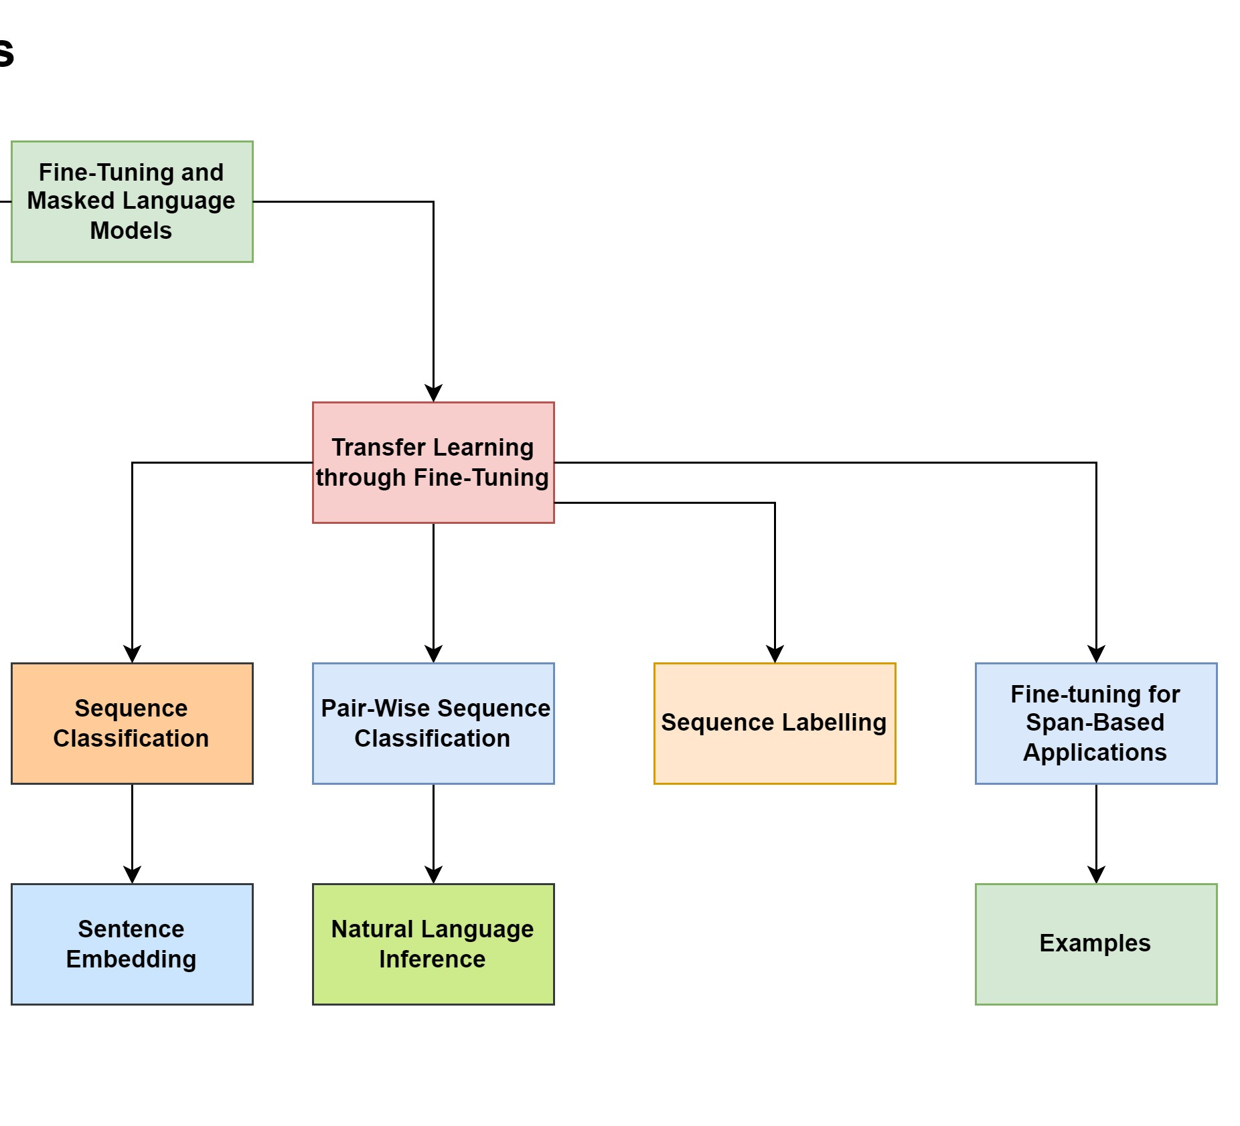

Slide 19
Transfer Learning through Fine-Tuning
Pretrained language models extract useful generalizations from large text datasets.
It creates interfaces between pretrained models and downstream applications.
It involves adding application-specific parameters to pretrained models.
Labeled data from the application is used to train these additional parameters.
Pretrained model parameters are typically frozen or minimally adjusted during fine-tuning.
Fine-tuning methods are introduced for
Sequence classification,
Labeling,
Sentence-pair inference and
Span-based operations.

Slide 20
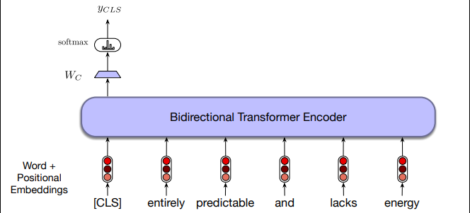
Sequence Classification
Sequence classification represents an input sequence
with a consolidated representation.
RNNs and transformers use a hidden layer or an additional vector as the sequence embedding.
In BERT, the [CLS] token serves as the embedding for the entire sequence.
Fine-tuning updates W_c with labeled training data and cross-entropy loss.
The loss can update pretrained language model weights.
Minimal changes are made to language model parameters.
Focus is often on final layers of the transformer.

Slide 21
Pair-Wise Sequence Classification
Fine-tuning for pair sequence classification involves using labeled sentence pairs, with the [CLS] token representing the input, to update the model's weights and generate predictions.
Natural Language Inference(MultiNLI) dataset is used for entailment classification.
It tasks involve classifying the relationship between a pair of sentences.
MultiNLI corpus has three labels: entails, contradicts, and neutral.
Labels describe the relationship between the premise and hypothesis sentences.
In MultiNLI, "contradicts" means premise contradicts hypothesis, "entails" means premise entails hypothesis, and "neutral" means neither is necessarily true.
Fine-tuning: premise/hypothesis pairs processed, [CLS] token output classified using MultiNLI.

Slide 22
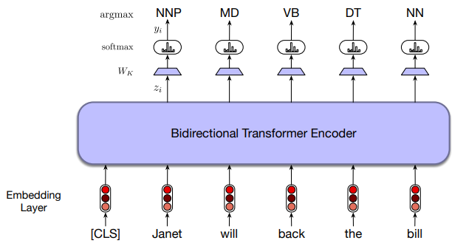
Sequence Labelling
Sequence labeling tasks, like part-of-speech tagging or named entity recognition, use a classification approach.
The final output vector for each token is passed to a classifier with softmax distribution over possible tags.
Subword tokenization can complicate alignment with BIO tags used in supervised training data.
Assigning BIO tags to subword tokens during training and recovering word-level tags during decoding is necessary.

Slide 23
Fine-tuning for Span-Based Applications
Span-oriented applications focus on contiguous token sequences, including tasks like named entity recognition, question answering, and coreference resolution.
A span is a contiguous sequence of tokens within an input sequence.
Fine-tuning span-based model: pretrained embeddings generate span representations, concatenate components.
Span representation: start/end token embeddings as boundaries, span average summarization.
Advanced methods: separate networks for start/end representations overcome span limitations.

Slide 24
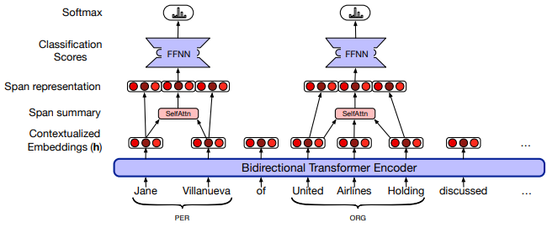
Fine-tuning for Span-Based Applications Cont.
Examples of fine-tuning for span-based applications include:
Named Entity Recognition (NER): Pretrained model fine-tuned for span classification of named entities.
Question Answering: A model to identify spans in a given text that answer specific questions.
Coreference Resolution: Fine-tuning model for entity coreference enhances text coherence.
Sentiment Analysis: A model to classify spans within a sentence that indicate positive, negative, or neutral sentiment.

Slide 25
Thank You.

